Slide 1

LR Parser for Evaluating and Differentiating Mathematical Expressions
Implementation and Comparison in Python and Haskell
Dor Shabat
Yuval Rozner
08/08/2024

Slide 2
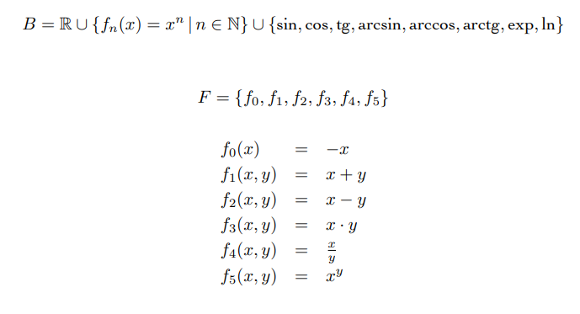

The Problem
The goal is to compute the value and derivative of a composite algebraic function.
Requirements:
Eval Function: Receives an algebraic function $F$ and a number $X$, returning the value of $F(X)$.
Diff Function: Receives an algebraic function $F$ and returns the derivative $F′(X)$ as a function.
Main Task:
Define $F(X)$ as a combination of 1000 characters and compute the value and derivative at a specific point $X$ using the following:
$Eval\left(F\left(X\right)\right), Diff\left(F\left(X\right)\right), Eval(Diff(F(X))$

Slide 3
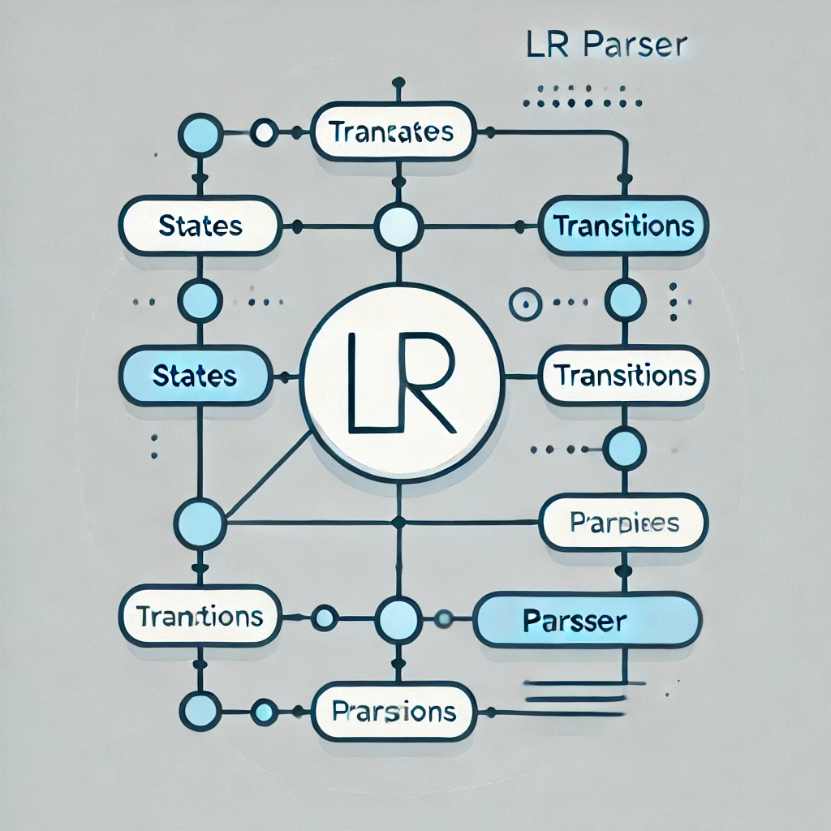

LR Parsing Overview
Context-Free Grammar:
Defining Context-Free Grammar (CFG)
$E→ E + T | E – T | T$
$T→ T ∗ F | T / F | FF −> G ^ F | G$
$G→ ( E ) | − G | Func ( E ) | NUMBER | X$
$Func→ sin⁡ | cos⁡ | tg⁡ | arcsin⁡ | arccos⁡ | arctg⁡ | exp⁡ | ln⁡$
Constructing the Automaton
Building the Parsing Table
Tokenize the Expression
Parsing the Expression
Evaluation
Differentiate

Slide 4
Parsing Table
We used a web tool in : https://cyberzhg.github.io/toolbox/ which construct automaton for LR(0) grammars and construct parsing table for given grammars.

Slide 5
Python Implementation Overview
Structure:
Tokenizer: Converts the input expression into a sequence of tokens (numbers, operators, functions, etc.).
LR Parser Class:
Implements the LR parsing logic using a predefined parsing table.
Handles two modes: Evaluation (computes the expression value) and Differentiation (builds a derivation tree).
Node Class: Represents nodes in an expression tree, used for differentiation and expression manipulation.
Key Features:
Easily Extensible Grammar: The implementation allows straightforward modification or expansion of the grammar to support additional operators or functions, making it adaptable to different mathematical needs.
Dynamic Typing: Python's flexibility with variable types simplifies handling various data forms, ensuring smooth integration and manipulation of different components in the parsing and evaluation process.

Slide 6
Haskell Implementation Overview
Structure:
Purely Functional Approach: Utilizes Haskell's functional programming paradigm to create a clear and concise parsing and evaluation logic.
Parsing Functions: Implements parsing through recursive functions and pattern matching, providing a robust mechanism for processing mathematical expressions.
Expression Tree: Uses Haskell’s strong typing and algebraic data types to build and manipulate expression trees for differentiation.
Key Features:
Mathematical Precision: Haskell’s syntax closely mirrors mathematical notation, making the implementation both concise and expressive.
Powerful Pattern Matching: Haskell’s pattern matching allows for elegant and readable handling of various cases, eliminating the need for verbose if-else chains and making the code more maintainable.
Custom Data Types: Haskell excels in defining new algebraic data types, enabling precise and flexible representations of mathematical structures and operations within the parser.

Slide 7

Performance Comparison
Evaluation and Differentiation Speed:
Python:
Generally slower due to dynamic typing and interpreter overhead.
Haskell:
Faster execution thanks to compilation and optimized functional code.
Strong typing and lazy evaluation contribute to efficient memory usage and performance.
Memory Usage:
Python: More memory-intensive due to dynamic typing and the overhead associated with interpreted languages.
Haskell: More memory-efficient, especially with large expressions, due to lazy evaluation and strict type definitions.
Accuracy and Reliability:
Both implementations produce accurate results, but Haskell's type safety reduces the likelihood of runtime errors, ensuring more reliable differentiation and evaluation over time.

Slide 8
Performance Comparison
Haskell LR Parser | Python LR Parser | Existing Python’s Solutions
0.00862 sec | 0.00489 sec | 0.00121 sec | Evaluation
0.00541 sec | 0.01023 sec | 0.1312 sec | Differentiate

Slide 9


Accuracy and Reliability
Validation and speed comparing against Python’s Eval and SymPy’s Diff:
Matches results with Python’s built-in eval function for expression evaluation.
Differentiation results are validated against SymPy, a well-known symbolic mathematics library.
Comparison: Both the result and the time taken for calculations are compared to ensure consistency and efficiency.

Slide 10
Pros of Python Implementation
Extensibility:
Easily Modifiable Grammar: The Python implementation allows for straightforward adjustments to the grammar, making it simple to add new operators or functions as needed.
Scalable for Different Mathematical Needs: Whether expanding the range of supported functions or modifying existing rules, Python’s flexibility supports rapid updates.
Dynamic Typing:
Flexibility with Variables: Python’s dynamic typing enables seamless handling of various data types without strict type declarations.
Ease of Visualization and Verification:
Tree Visualization: Python’s support for libraries like Graphviz makes it straightforward to visualize the expression trees, aiding in debugging and understanding the parser’s behavior.
Interactive Exploration: Python’s support for libraries like sympy allow verifying easily the results of the parser and the evaluations and differentiate.
Object-Oriented Programming (OOP):
Structured Codebase: Python’s OOP capabilities help in organizing the code into classes like LRParser and Node, making it modular and easier to maintain.

Slide 11
Pros of Haskell Implementation
High Performance:
Compiled Language: Haskell’s compilation into machine code results in faster execution times, particularly beneficial for large and complex mathematical expressions.
Efficient Memory Management: Haskell's lazy evaluation model optimizes memory usage, only computing values when necessary.
Strong Typing:
Compile-Time Error Checking: Haskell’s strong, static type system catches many errors during compilation, reducing the likelihood of runtime errors.
Type Safety: Ensures that operations are performed on compatible types, enhancing the reliability and robustness of the parser.
Mathematical Precision:
Expressive Syntax: Haskell’s syntax closely mirrors mathematical notation, making the implementation concise and aligned with mathematical logic.
Custom Data Types:
Flexibility in Data Representation: Haskell allows the creation of new algebraic data types, providing precise and flexible representations of complex mathematical structures.
Enhanced Abstraction: Custom data types enable high levels of abstraction, making the code more modular and easier to reason about.

Slide 12








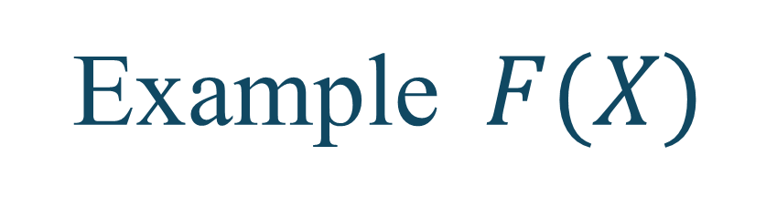

Example $F(X)$
$$F\left(X\right)=$$

Slide 13









Example $F′(X)$
$$F′\left(X\right)=$$

Slide 14
Thank You !
Dor Shabat
Yuval Rozner

